Slide 1
Dominance and valenced interactions in social networks

Slide 2
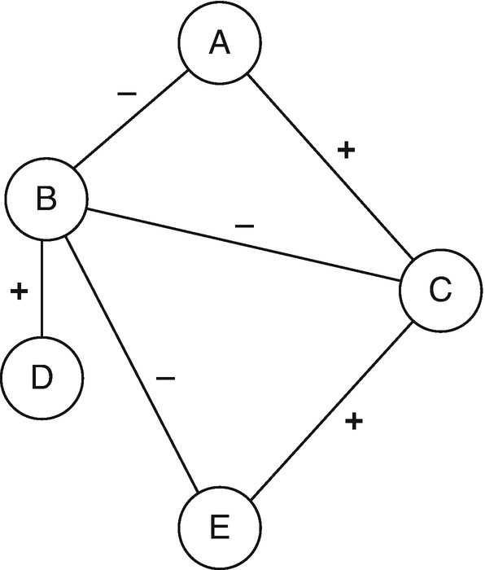
Valenced interactions
Most social network theories assume ties and network flows are usually positive or neutral:
  Ties
    Friendship
    Kinship
    Co-membership
  Flows
    Information
    Support
    Gossip
    Violence

Slide 3
Valenced interactions
Most real-world social networks feature a mix of:
  Positive and negative ties:
    Friends and enemies
    Liking and disliking
    Members of same group versus rival groups
  Positive and negative flows:
    Gossip versus compliments
    Helping versus violence
These are called valenced relationships

Slide 4
Valenced interactions
Core network concepts change meaning when ties are valenced!
  In-degree centrality:
    Friendship (good)
    Disliking (bad!)
    Support (good!)
    Enemies (bad?)
  The same goes for out-degree:
    A bully is a person who has lots of outgoing negative ties
  And other network metrics:
    Eigenvector centrality

Slide 5
Valenced interactions
We have seen on network theory (balance) designed to explain valenced relationships
But this is not the only approach!
  Status theory
    (an extension of balance theory)

Slide 6
Valenced interactions: Status theory
Ego
Other
Neg.
Pos.
Status Theory
  Designed to explain distribution of positive and negative ties in valenced networks with directed ties
First principle:
  Status in valenced networks is determined by sign of ties received
    High status
      Lots of incoming positive ties
    Low status
      Lots of incoming negative ties
    Directed positive tie from i →j:
      I thinks of j as higher status
High Status
Low Status

Slide 7
Valenced interactions: Status theory
Ego
Other
Neg.
Pos.
Status Theory
  Designed to explain distribution of positive and negative ties in valenced networks with directed ties
First principle:
  Status in valenced networks is determined by sign of ties received
    High status
      Lots of incoming positive ties
    Low status
      Lots of incoming negative ties
    Directed negative tie from i →j:
      I thinks of j as lower status
High Status
Low Status

Slide 8
Valenced interactions: Status theory
Ego
Other
Neg.
Pos.
Status Theory
  Designed to explain distribution of positive and negative ties in valenced networks with directed ties
Second principle:
  Status of nodes is also determined by the sign of their connections to (high and low status) others
    Positive ties to high status others increase status
    Positive ties to low status others decrease status
Status Boost
Status Loss

Slide 9
Valenced interactions: Status theory
Ego
Other
Neg.
Pos.
Status Theory
  Designed to explain distribution of positive and negative ties in valenced networks with directed ties
Second principle:
  Status of nodes is also determined by the sign of their connections to (high and low status) others
    Positive ties to high status others increase status
    Positive ties to low status others decrease status
Status Boost
Status Loss

Slide 10
Valenced interactions: Status theory
Ego
Other
Neg.
Pos.
Status Theory
  Designed to explain distribution of positive and negative ties in valenced networks with directed ties
Second principle:
  Status of nodes is also determined by the sign of their connections to (high and low status) others
    Negative ties to high status others decrease status
    Negative ties to low status others increase status
Status Loss
Status Boost

Slide 11
Valenced interactions: Status theory
Ego
Other
Neg.
Pos.
Status Theory
  Designed to explain distribution of positive and negative ties in valenced networks with directed ties
Second principle:
  Status of nodes is also determined by the sign of their connections to (high and low status) others
    Negative ties to high status others decrease status
    Negative ties to low status others increase status
Status Loss
Status Boost

Slide 12
Valenced interactions: Status theory
Ego
Other
Neg.
Pos.
Status Theory
  Designed to explain distribution of positive and negative ties in valenced networks with directed ties
Third principle:
  People aim to avoid status loss and seek status boosts:
    High status individuals will accumulate positive ties
      Rich get richer effect
Time 1
Time 2

Slide 13
Valenced interactions: Status theory
Ego
Other
Neg.
Pos.
Status Theory
  Designed to explain distribution of positive and negative ties in valenced networks with directed ties
Third principle:
  People aim to avoid status loss and seek status boosts:
    Low status individuals will accumulate negative ties
      “Gang up” effect
Time 1
Time 2

Slide 14
Valenced interactions: Status theory
Ego
Other
Neg.
Pos.
Status Theory
  Designed to explain distribution of positive and negative ties in valenced networks with directed ties
Third principle:
  People aim to avoid status loss and seek status boosts:
    High status individuals will lose negative ties
Time 1
Time 2

Slide 15
Valenced interactions: Status theory
Ego
Other
Neg.
Pos.
Status Theory
  Designed to explain distribution of positive and negative ties in valenced networks with directed ties
Third principle:
  People aim to avoid status loss and seek status boosts:
    Low status individuals will lose positive ties
Time 1
Time 2

Slide 16
Valenced interactions: Karma theory
Ego
Other
Neg.
Pos.
Karma Theory: You get what you spread out!
  Status theory is based on (negative and positive) popularity
    Graph theoretic indegree centrality
  Karma theory is based on (negative and positive) activity
    Graph theoretic outdegree centrality
Time 1
Time 2

Slide 17
Valenced interactions: Karma theory
Ego
Other
Neg.
Pos.
Karma Theory: You get what you spread out!
  Status theory is based on (negative and positive) popularity
    Graph theoretic indegree centrality
  Karma theory is based on (negative and positive) activity
    Predict valenced indegree (what you get) from valenced outdegree (what you spread)
Time 1
Time 2

Slide 18
Valenced interactions: Karma theory
Ego
Other
Neg.
Pos.
Karma Theory: You get what you spread out!
  Status theory is based on (negative and positive) popularity
    Graph theoretic indegree centrality
  Karma theory is based on (negative and positive) activity
    Predict valenced indegree (what you get) from valenced outdegree (what you spread)
Bullies get bullied!
Time 2
Time 1

Slide 19
Valenced interactions: Karma theory
Ego
Other
Neg.
Pos.
Karma Theory: You get what you spread out!
  Status theory is based on (negative and positive) popularity
    Graph theoretic indegree centrality
  Karma theory is based on (negative and positive) activity
    Predict valenced indegree (what you get) from valenced outdegree (what you spread)
Likers get liked!
Time 2
Time 1

Slide 20
Valenced interactions: Solidarity theory
Ego
Other
Neg.
Pos.
Solidarity Theory
  People in the same position in the valenced interaction network are likely to link via positive ties
Two types of solidarity:
  Status solidarity
  Karma solidarity
Time 1
Time 2

Slide 21
Valenced interactions: Solidarity theory
Ego
Other
Neg.
Pos.
Solidarity Theory
  People in the same position in the valenced interaction network are likely to link via positive ties
Two types of solidarity:
  Status solidarity
  Karma solidarity
Popular “in-crowd” effect
Time 2
Time 1

Slide 22
Valenced interactions: Solidarity theory
Ego
Other
Neg.
Pos.
Solidarity Theory
  People in the same position in the valenced interaction network are likely to link via positive ties
Two types of solidarity:
  Status solidarity
  Karma solidarity
The downtrodden stick together!
Time 2
Time 1

Slide 23
Valenced interactions: Solidarity theory
Ego
Other
Neg.
Pos.
Solidarity Theory
  People in the same position in the valenced interaction network are likely to link via positive ties
Two types of solidarity:
  Status solidarity
  Karma solidarity
Bullies stick together!
Time 2
Time 1

Slide 24
Valenced interactions: Solidarity theory
Ego
Other
Neg.
Pos.
Solidarity Theory
  People in the same position in the valenced interaction network are likely to link via positive ties
Two types of solidarity:
  Status solidarity
  Karma solidarity
Cool kids stick together!
Time 2
Time 1

Slide 25
An Angle of What Sociology Is
Some scholars are still of the opinion that sociology is not only without form and void, but that it must forever remain so, because nothing in the nature of things sanctions it; and the name is therefore merely a device to give new theorists a place. These critics know little about the deep currents of present popular thought. It is a very callow sociologist who imagines that he and his colaborers are inventing the subject-matter of a new science. They are trying to perfect means of answering obtrusive questions about society which the ordinary man is proposing every hour (AJS Editors 1895:6, italics added).

Slide 26
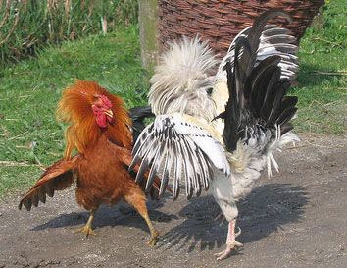
Dominance orders among animals
Dominance hierarchies:
  Observed across a number of species in the animal kingdom
  Including (most notably) among chickens
  You do not need a big brain to create a (complex) social network!
“Pure” dominance order:
  Directed
    A dominates B
  Anti-symmetric
    If A dominates B then B cannot dominate A

Slide 27
Dominance orders among animals
Dominance hierarchies:
  Observed across a number of species in the animal kingdom
  Including (most notably) among chickens
  You do not need a big brain to create a (complex) social network!
“Pure” dominance order:
  Complete (all ties present)
    Either A dominates B or B dominates A

Slide 28
Dominance orders among animals
Dominance hierarchies:
  Observed across a number of species in the animal kingdom
  Including (most notably) among chickens
  You do not need a big brain to create a (complex) social network!
“Pure” dominance order:
  Transitive (all ties present)
    If A dominates B, and B dominates C, then by necessity A dominates C

Slide 29
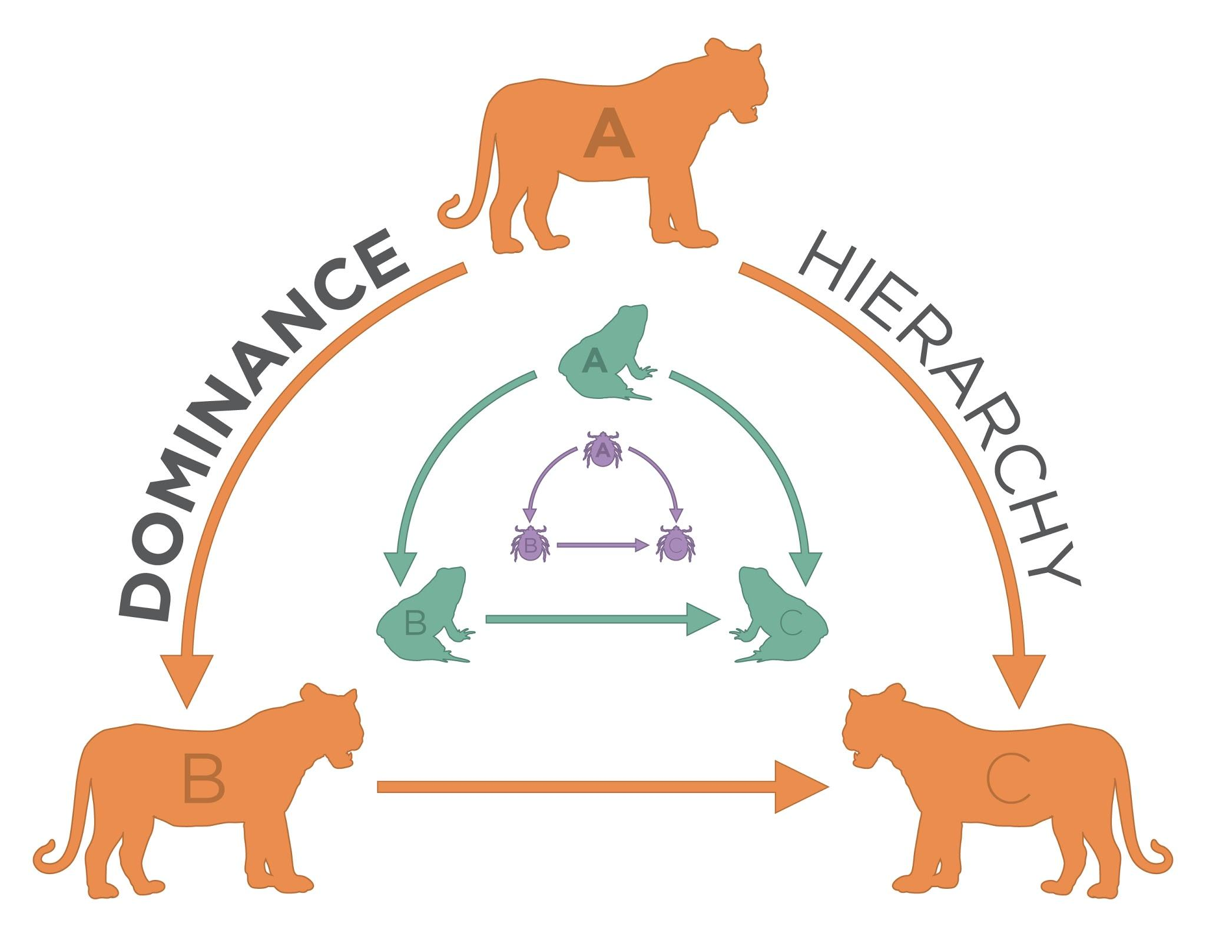
Algebraic Requirements for Dominance Order
A linear dominance order is transitive
Transitivity is a relation between node triples
  If a has dominates b, and b dominates c
  Then a necessarily dominates c
a
b
c
This arc has to exist!
Transitive Triad

Slide 30
Algebraic Requirements for Dominance Order
A linear dominance order contains no cyclical triads
  Flashback: A cycle is a path that begins and ends with the same node
a
b
c
This would be weird!
Cyclical Triad

Slide 31
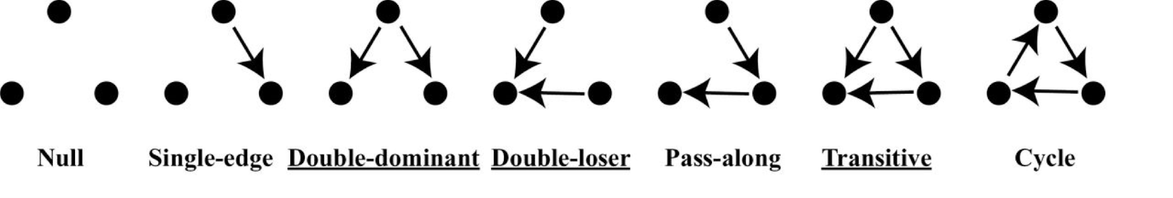
The emergence of dominance hierarchies
Dominance order can be represented as dominance network
  Nodes are animals (whether human or not)
  Directed, antisymmetric links indicate that animal i dominates animal j
Types of possible triads in dominance networks:

Slide 32
The emergence of dominance hierarchies
Dominance order can be represented as dominance network
  Nodes are animals (whether human or not)
  Directed, antisymmetric links indicate that animal i dominates animal j
Types of expected triads in dominance networks:

Slide 33
Different Types of Animal Orders
Macaques: Matrilineal Hierarchy
Gorillas, Chimpanzees: Female order more fluid than male, male hierarchy
Patas Monkeys: Female linear, one male
Vervets, Sykes Monkeys: Each sex has internal rankings
Wooly Spider Monkey: No dominance order
Lemur: Monogamous couples
Orangutan: Solitary
Homo Sapien: We’re working on it

Slide 34
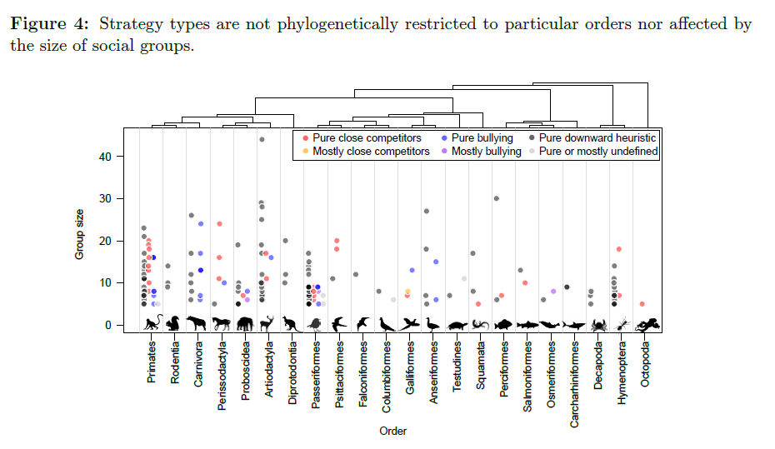
Hobson, Monster, DeDeo 2018

Slide 35
The emergence of dominance hierarchies
Chickens form perfectly linear hierarchies (breaks down at about 10)
How are these social structures formed?
  An attribute based-model says position in the hierarchy is a function of individual characteristics (size, age, strength, etc.)
How do we go from:
This
To this?

Slide 36
The emergence of dominance hierarchies
Chickens form perfectly linear hierarchies (breaks down at about 10)
How are these social structures formed?
  A interaction-based model says the hierarchie emerges from local network processes partially independently from attributes
How do we go from:
This
To this?

Slide 37
Agonistic Competition as Iterative and Social
Three possible mechanisms:
  Winner Effects
    Confidence, testosterone boost, experience
    Emergence of double-dominant triads
  Loser Effects
    Lowered confidence, injury
    Emergence of double-loser triads
  Bystander Effects
    Confidence vis-a-vis winner and loser changes
    From single-edge to either:
      Double-dominant triads
Winner Effects
Loser Effects
Bystander Effects
Time 1
Time 2

Slide 38
Agonistic Competition as Iterative and Social
Three possible mechanisms:
  Winner Effects
    Confidence, testosterone boost, experience
    Emergence of double-dominant triads
  Loser Effects
    Lowered confidence, injury
    Emergence of double-loser triads
  Bystander Effects
    Confidence vis-a-vis winner and loser changes
    From single-edge to either:
      Double-loser triads
Winner Effects
Loser Effects
Bystander Effects
Time 1
Time 2

Slide 39
Agonistic Competition as Iterative and Social
Three possible mechanisms:
  Winner Effects
    Confidence, testosterone boost, experience
    Emergence of double-dominant triads
  Loser Effects
    Lowered confidence, injury
    Emergence of double-loser triads
  Bystander Effects
    Bystanders almost never dominate initial dominant
Winner Effects
Loser Effects
Bystander Effects
Weird!
Time 1
Time 2

Slide 40
Agonistic Competition as Iterative and Social
Three possible mechanisms:
  Winner Effects
    Confidence, testosterone boost, experience
    Emergence of double-dominant triads
  Loser Effects
    Lowered confidence, injury
    Emergence of double-loser triads
  Bystander Effects
    Bystanders almost never dominate initial dominant
    Bystanders almost never get dominated by initial loser
Winner Effects
Loser Effects
Bystander Effects
Also
Weird!
Time 1
Time 2

Slide 41
Agonistic Competition as Iterative and Social
Three possible mechanisms:
  Winner Effects
    Confidence, testosterone boost, experience
    Emergence of double-dominant triads
  Loser Effects
    Lowered confidence, injury
    Emergence of double-loser triads
  Bystander Effects
    Bystanders almost never dominate initial dominant
    Bystanders almost never get dominated by initial loser
    This guarantees transitivity and linearity!
Winner Effects
Loser Effects
Bystander Effects
Also
Weird!
Time 1
Time 2

Slide 42
Self-Confidence and Victory
Self confidence is associated with winning social contests, but comes from many other attributes
-Individual Characteristics
  Strength, age, intelligence, etc.
-Social Characteristics
  Past wins, family descent
Contestation is mostly about ritual, and so self-confidence is a great way to win at ritual contestation. Contestation is often a game of chicken.

Slide 43
Understanding Structure
We might, from the micro-foundations of agonistic encounters, build up to social structure (Chase 1982)
Key point is that intransitive triads become transitive in such situations

Slide 44
Intransitive to Transitive
Red is a really important node
https://www.youtube.com/watch?v=zTqmiJ4LW9c

Slide 45

Hierarchy as Exchange
Roger Gould’s Model of Relationship’s as Exchange
u is utility, a is the tie strength/deference, q is quality, s is desire for reciprocity
In end, the model is driven by the quality of actors and deference

Slide 46
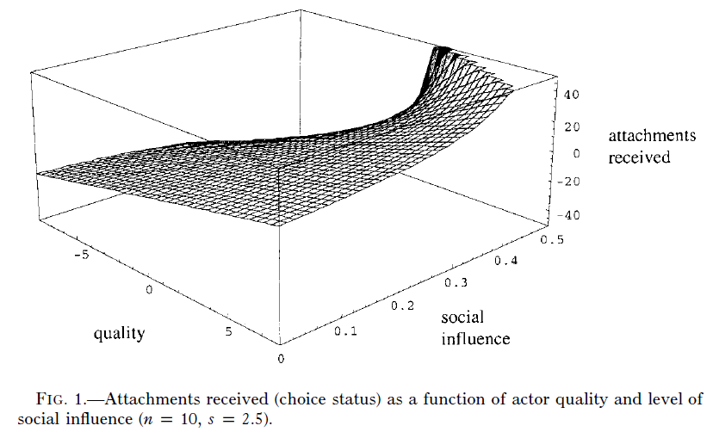
Find that Results Vary

Slide 47
You Always Hurt the One You Love
Obvious explanation: Bully’s target the weak because they themselves are insecure, mean people
Sociology explanation: Most bullying is done by your friends because they are insecure, mean people. But aren’t we all?
Recap of Felmlee and Faris 2016

Slide 48
Because It Works (But It’s Still Mean)
Why Go After Friends and Dating Partners?
We can think of rumors as agonistic encounters where we are interested in changing the symmetry of relationships
Felmlee and Faris 2016

Slide 49
The overlaying of positive and negative ties
Commonalities between positive and negative ties in social networks
  Friends and Enemies are:
    Socially close to us in some way
    We compete with them for the attention of others who we are also competing with (clubs, workplaces, teams)
    We also compete for socially close romantic partners, or remain socially close to them after a breakup
Felmlee and Faris 2016

Slide 50
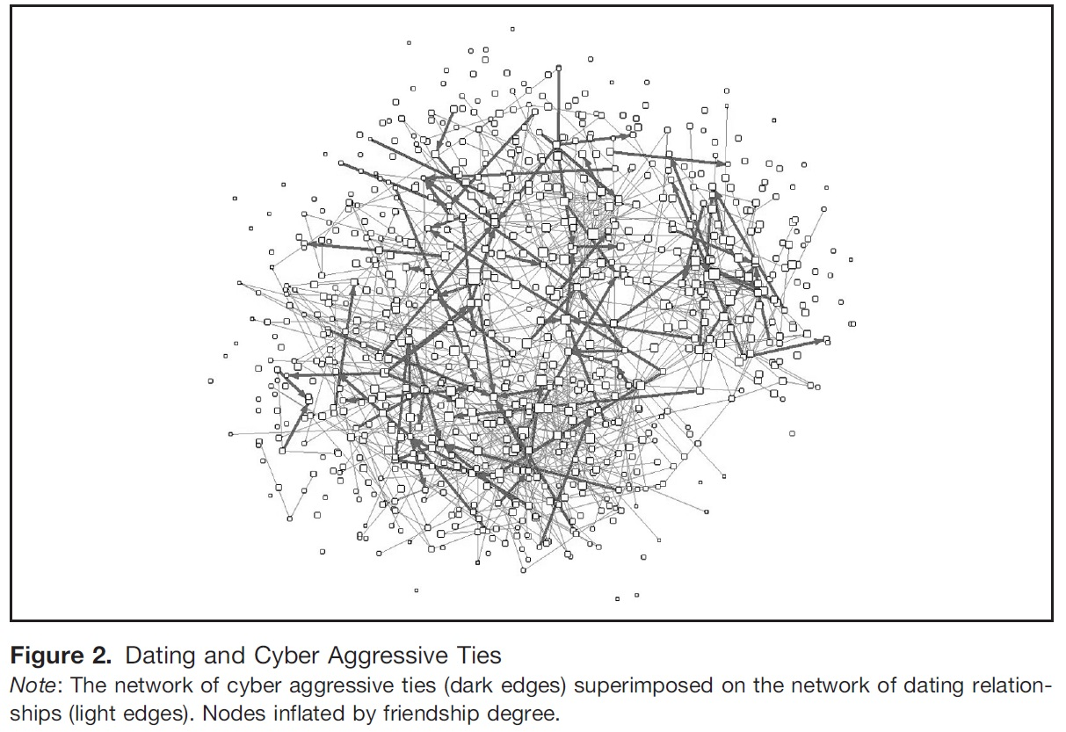
Felmlee and Faris 2016

Slide 51
Who are Targets of Rumors?
-Same Grade 8-11 (not 12)
-In Grades 9-11 (not 12)
-Female
-LGBTQ
-Friends
-Dating Partners
Felmlee and Faris 2016

Slide 52
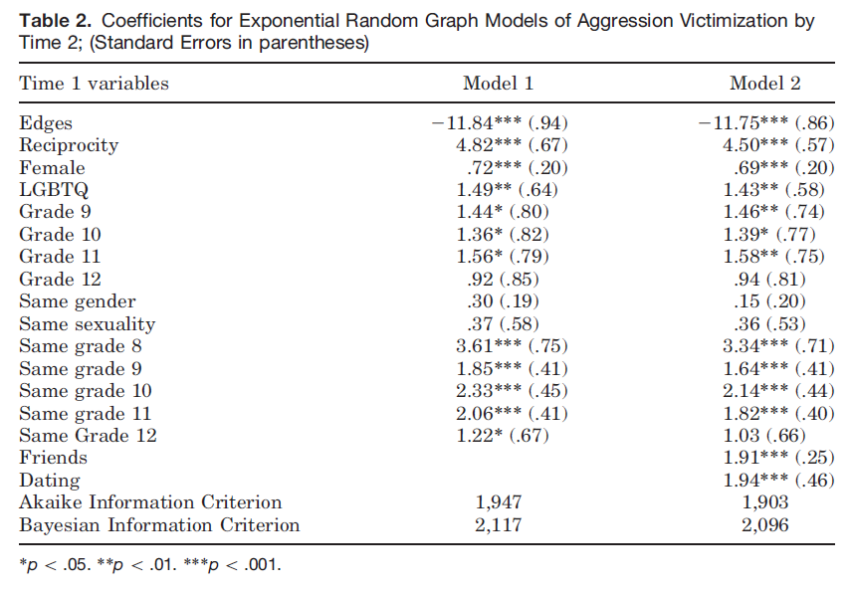
How can we make claims about these different social processes? Math beyond this class

Slide 53
Violence Never Solves Anything, Except Agonistic Encounters
Obvious explanation: Gangs fight over drug routes
Sociology explanation: Status competition between local groups
Recap of Papachristos 2009

Slide 54
Why Fighting Occurs
Gould- Ambiguity leads to violence as unclear hierarchy leads to competition
Implication that equals are more likely to have competition escalate
  Three types of competitive strategies to consider:
    Downward Competition: High status go after any lower status individual
    Close Competitors: Individuals fight those close in status to themselves
    Bullying: High individuals only fight those much lower than themselves

Slide 55
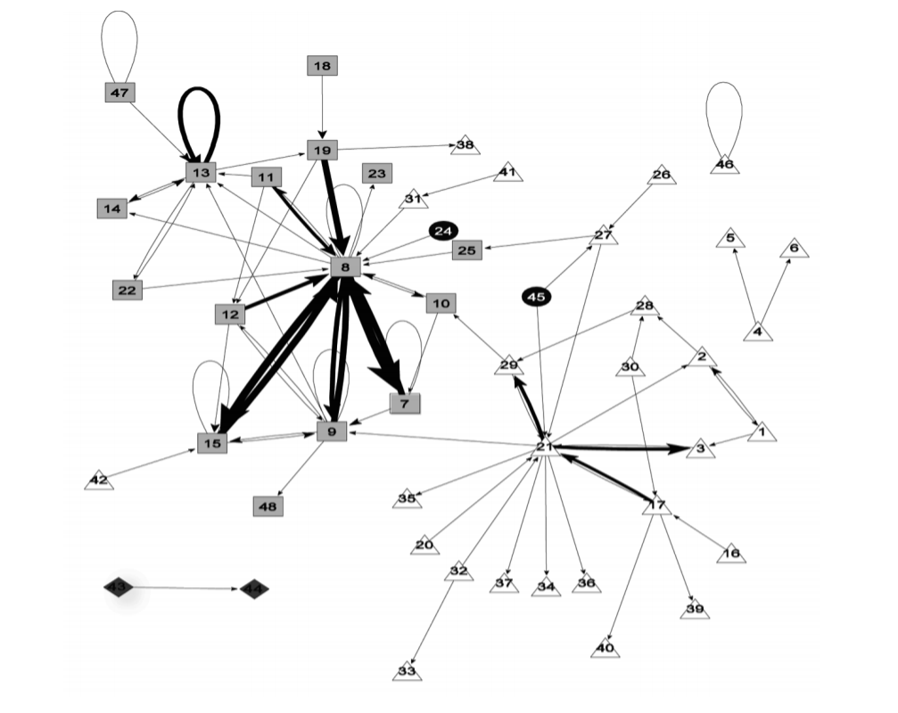
Black
Racial Homophily
Number of Nodes: 48
Density: 0.07
Reciprocal dyads: 36
Self-loops
Hispanic
Asian
White
The social structure of gang homicide in Chicago, 1994
Papachristos 2009

Slide 56
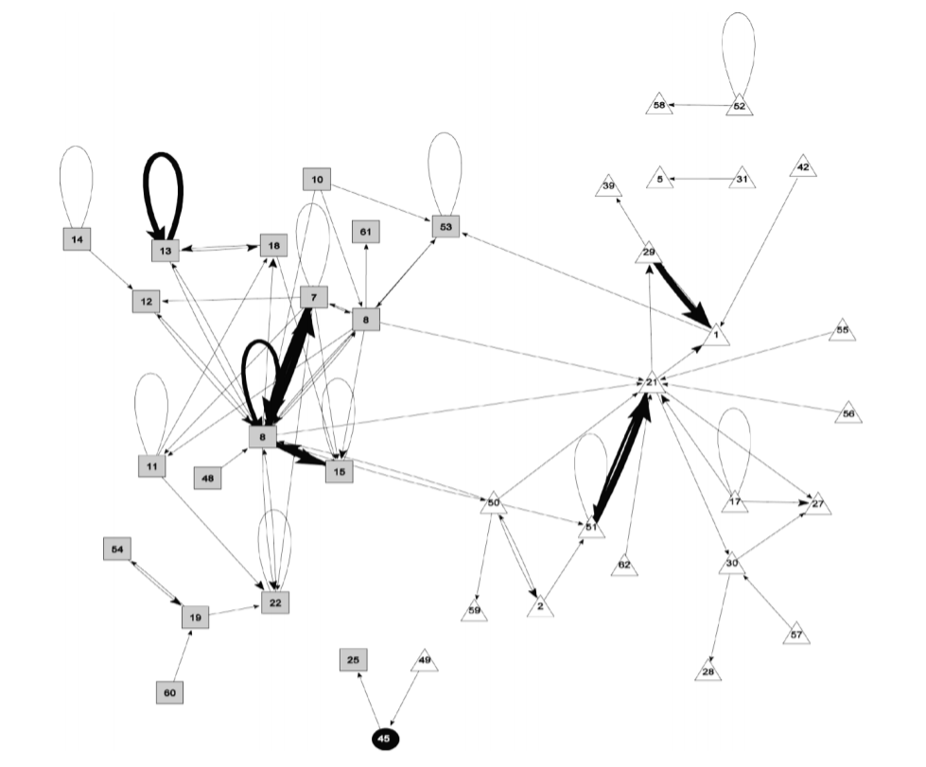
Black
Hispanic
Asian
White
The social structure of gang homicide in Chicago, 1998
Papachristos 2009

Slide 57
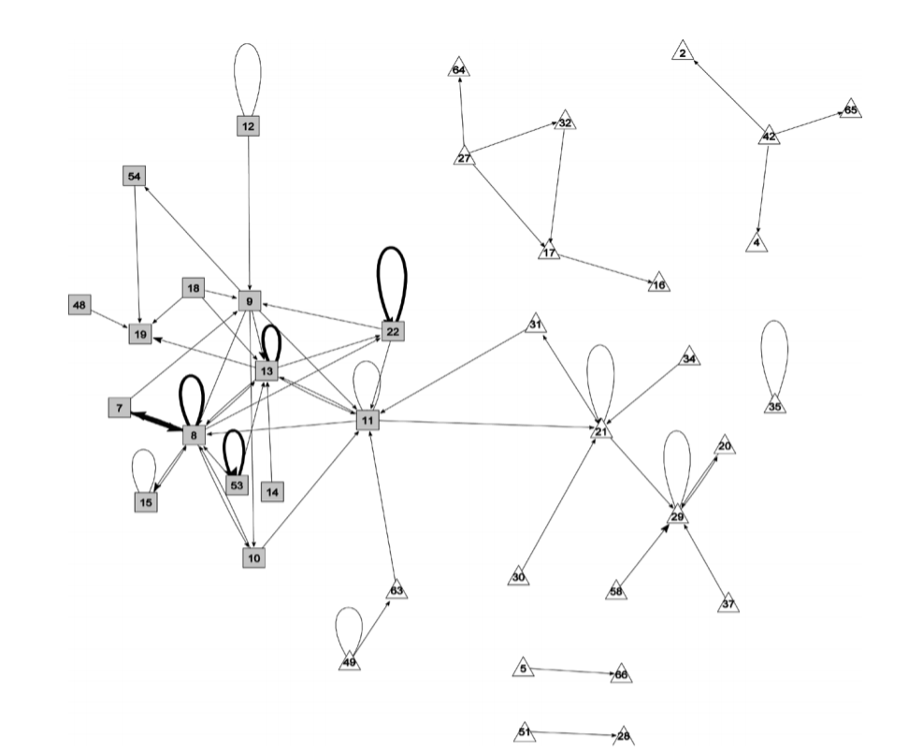
Black
Hispanic
Asian
White
The social structure of gang homicide in Chicago, 2002
Papachristos 2009

Slide 58
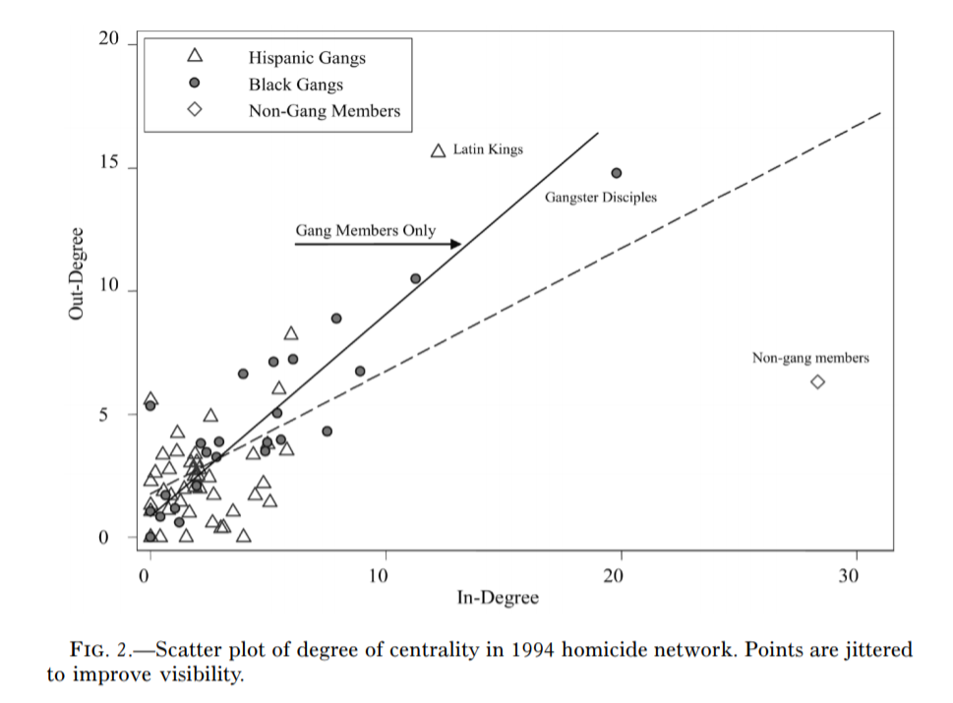
Black
Hispanic
Asian
White
The social structure of gang homicide in Chicago, 1994
Papachristos 2009

Slide 59
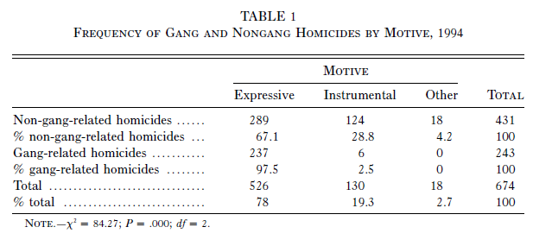
Rare for Instrumental Violence in Gangs

Slide 60
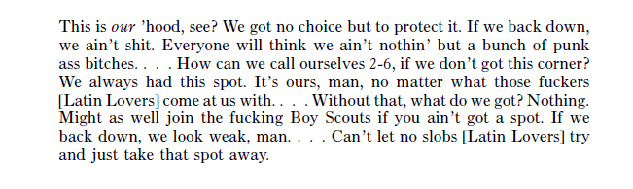
Melo

Slide 61
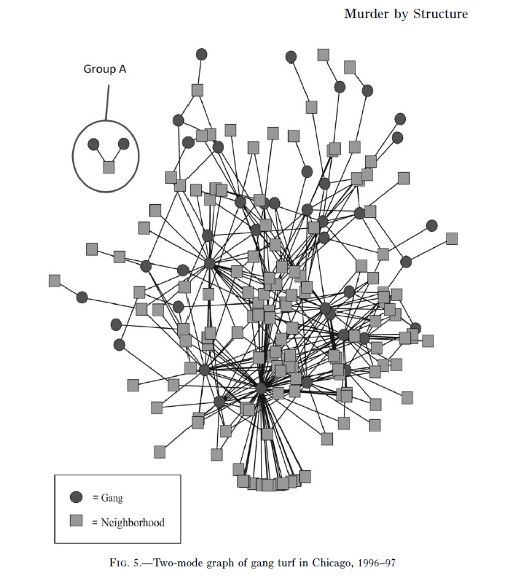
Papachristos 2009

Slide 62
When does violence occur?
Average overlap between 2 gangs: 10%
Overlap that results in murder: 25%+
Every 1% increase doubles the probability of a murder increasing
Not unusual, peace
Very bad things happen

Slide 63
When does violence occur?
Papachristos argues we can think of murder as a network phenomenon
Crime is not some individual in isolation responding to a set of deprivations, but inherently a social phenomena
Not unusual, peace
Very bad things happen

Slide 64
Two ways violence spreads
Murder
Murder
Gang 1
Gang 2
Gang 1
Gang 2
Payback
Gang 3
Gang 3
Time 1
Time 2
Direct Retaliation

Slide 65
Two ways violence spreads
Murder
Murder
Gang 1
Gang 2
Gang 1
Gang 2
Gang 3
Gang 3
Show of force
Time 1
Time 2
Generalized Violence

Slide 66
Negative Reciprocity-When More Likely?
Gould: Negative reciprocity more likely amongst equals (like high school)
Papachristos: Finds it actually more likely between unequally sized gangs
-part of this finding driven by Latin Kings and Gangster Disciple size
We don’t truly understand all the reasons and scope conditions as to why this is true...

Slide 67
Negative Reciprocity-When More Likely?
Gould: Negative reciprocity more likely amongst equals (like high school)
Papachristos: Finds it actually more likely between unequally sized gangs
-part of this finding driven by Latin Kings and Gangster Disciple size
We don’t truly understand all the reasons and scope conditions as to why this is true...

